Slide 1
Introduction to mNGS*& lab setup *metagenomic Next-Generation Sequencing

Slide 2

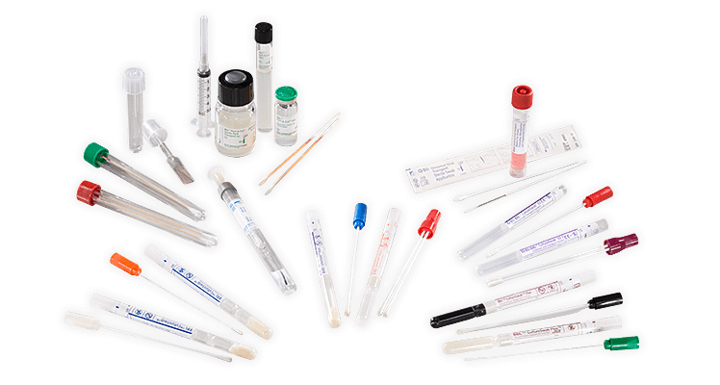



Introduction
Pathogen landscape
Sample landscape
NGS toolbox for infectious diseases
Notes:
We will begin by understanding the fundamental differences in pathogen nucleic acid and specimen collection that influence one’s ability to make a sequencing library. Then we will describe the different types of next generation sequencing that can applied to infectious disease questions.

Slide 3

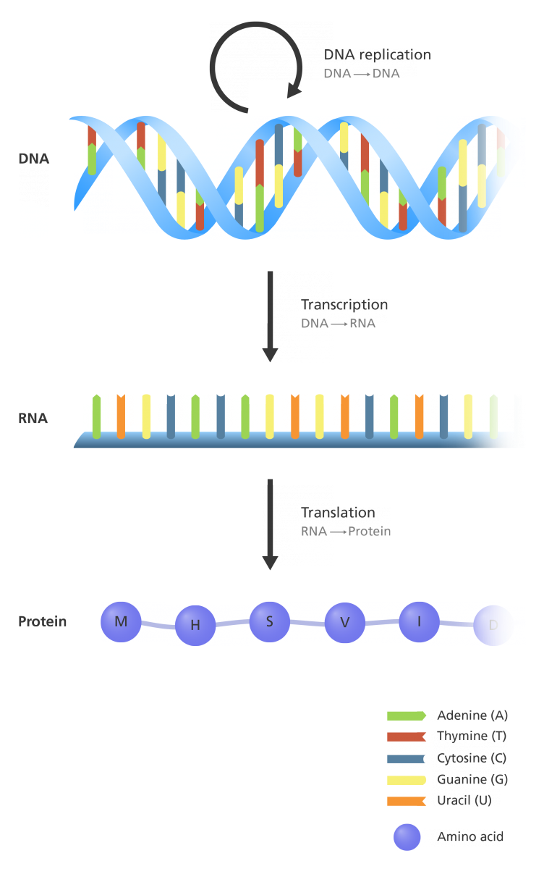



Pathogen landscape Organisms vary widely in their genetic makeup
DNA replication by DNA polymerases
DNA → DNA
 | Viruses | Bacteria | Eukaryotic microbes (yeast, amoebas, worms, etc)
Genome composition | ssRNA, ssDNA, dsDNA, or dsRNA | dsDNA | dsDNA
Ribosomal RNA | None, uses host ribosomes | 16S rRNA | 18S rRNA
Genome size | 2 Kb - 1 Mb | 2 Mb - 8 Mb | 200 Kb - 100,000 Mb
Transcription by RNA polymerases
DNA → RNA
Translation by ribosomes
RNA → Protein
Adapted from yourgenome.org
Notes:
In terms of pathogens, in the order of small to large, we have viruses, bacteria and then eukaryotic microbes. When trying to sequence any of these known or unknown pathogens, there are a few issues to keep in mind which will influence detection, identification, and surveillance. First, genome composition, while bacteria and eukaryotic microbes contain a DNA genome, some viruses only have RNA genomes. Therefore when using sequencing to identify unknown pathogens that could be viral, it is best to perform RNA sequencing rather than DNA sequencing. When performing RNA sequencing, we know that most of the RNA sequencing will be from ribosomal RNA (rRNA) rather than messenger RNA. One advantage is that rRNA can help type the bacteria (such as 16S seq methods) however if your sample has a lot of host background, you will mostly sequence host rRNA.

Slide 4

Sample type landscape
Nasal or oral swab
50% microbial (mostly bacteria)
Different sample types have different RNA contents!
Cerebral Spinal Fluid
No infection: 0% microbial
With infection: <1% - 5%
Whole Blood: lot of background
No infection:
During infection: <<<0% microbial
Tracheal Aspirate
5% microbial, 95% human
Serum or Plasma
10-100x less host material
Host
Microbial
Rectal or Vaginal swabs or stool
50% microbial (mostly bacteria)
Notes:
Different sample types have different RNA content host vs microbiome vs pathogen

Slide 5
NGS toolbox for infectious diseases
 | Whole genome & transcriptome sequencing | Amplicon sequencing | 16S & 18S rRNA sequencing | Metagenomic (shotgun) sequencing
Starting material | DNA/RNA from (cultured) isolate | DNA/RNA from a sample | DNA/RNA from a sample | DNA/RNA from a sample
Primers used to amplify sequences | Random primers | Organism-specific primers | 16S/18S-specific primers | Random primers
What is sequenced? | Organism of interest | O rganism of interest | rRNA from all bacteria, fungi and eukaryotic pathogens in sample | All DNA/RNA from all organisms in sample
Resulting data | DNA sequence or gene expression of target organism | RNA/DNA sequence of targeted organism | rRNA sequences of all bacteria, fungi and eukaryotic pathogens | All DNA/sequences from all organisms in sample

Slide 6
NGS toolbox for infectious diseases
 | Whole genome & transcriptome sequencing | Amplicon sequencing | 16S & 18S rRNA sequencing | Metagenomic (shotgun) sequencing
Starting material | DNA/RNA from (cultured) isolate | DNA/RNA from a sample | DNA/RNA from a sample | DNA/RNA from a sample
Primers used to amplify sequences | Random primers | Organism-specific primers | 16S/18S-specific primers | Random primers
What is sequenced? | Organism of interest | Organism of interest | rRNA from all bacteria, fungi and eukaryotic pathogens in sample | All DNA/RNA from all organisms in sample
Resulting data | DNA sequence or gene expression of target organism | RNA/DNA sequence of targeted organism | rRNA sequences of all bacteria, fungi and eukaryotic pathogens | All DNA/sequences from all organisms in sample

Slide 7
NGS toolbox for infectious diseases
 | Whole genome & transcriptome sequencing | Amplicon sequencing | 16S & 18S rRNA sequencing | Metagenomic (shotgun) sequencing
Starting material | DNA/RNA from (cultured) isolate | DNA/RNA from a sample | DNA/RNA from a sample | DNA/RNA from a sample
Primers used to amplify sequences | Random primers | Organism-specific primers | 16S/18S-specific primers | Random primers
What is sequenced? | Organism of interest | Organism of interest | Only rRNA from bacteria, fungi and eukaryotic pathogens in sample | All DNA/RNA from all organisms in sample
Resulting data | DNA sequence or gene expression of target organism | RNA/DNA sequence of targeted organism | Only rRNA sequences of bacteria, fungi and eukaryotic pathogens | All DNA/sequences from all organisms in sample

Slide 8
NGS toolbox for infectious diseases
 | Whole genome & transcriptome sequencing | Amplicon sequencing | 16S & 18S rRNA sequencing | Metagenomic (shotgun) sequencing
Starting material | DNA/RNA from (cultured) isolate | DNA/RNA from a sample | DNA/RNA from a sample | DNA/RNA from a sample
Primers used to amplify sequences | Random primers | Organism-specific primers | 16S/18S-specific primers | Random primers
What is sequenced? | Organism of interest | Organism of interest | Only rRNA from bacteria, fungi and eukaryotic pathogens in sample | DNA/RNA from all organisms in sample
Resulting data | DNA sequence or gene expression of target organism | RNA/DNA sequence of targeted organism | Only rRNA sequences of bacteria, fungi and eukaryotic pathogens | DNA/RNA sequences from all organisms in sample

Slide 9
NGS toolbox for infectious diseases
 | Whole genome & transcriptome sequencing | Amplicon sequencing | 16S & 18S rRNA sequencing | Metagenomic (shotgun) sequencing
Starting material | DNA/RNA from (cultured) isolate | DNA/RNA from a sample | DNA/RNA from a sample | DNA/RNA from a sample
Primers used to amplify sequences | Random primers | Organism-specific primers | 16S/18S-specific primers | Random primers
What is sequenced? | Organism of interest | Organism of interest | Only rRNA from bacteria, fungi and eukaryotic pathogens in sample | DNA/RNA from all organisms in sample
Resulting data | DNA sequence or gene expression of target organism | RNA/DNA sequence of targeted organism | Only rRNA sequences of bacteria, fungi and eukaryotic pathogens | DNA/RNA sequences from all organisms in sample
Use cases | Fundamental research on cultured organisms | Full genomes from clinical samples for genomic epidemiology | Exploratory studies on environmental samples | Outbreak research, co-infections, ...

Slide 10



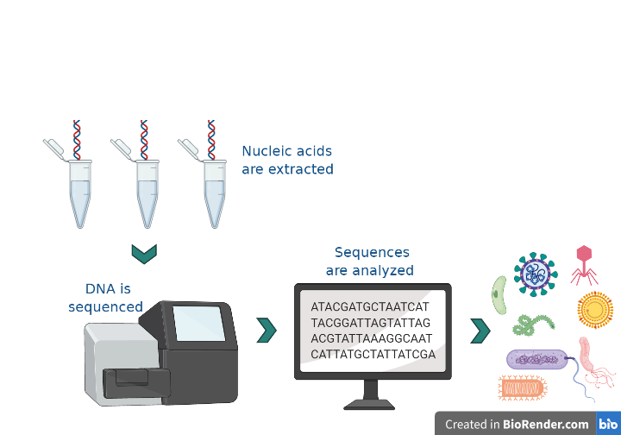
mNGS
Metagenomic next generation sequencing
Comprehensive analysis of all of the genetic material present in a sample
RNA or DNA mNGS? That depends on your pathogen(s) of interest...
Revised 01/12/2026

Slide 11
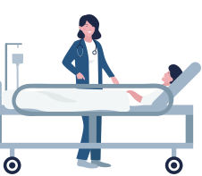




Use cases for mNGS
Identify a novel pathogen
Outbreak detection and prevention
Identify coinfections
Characterize the microbial landscape
+

Slide 12

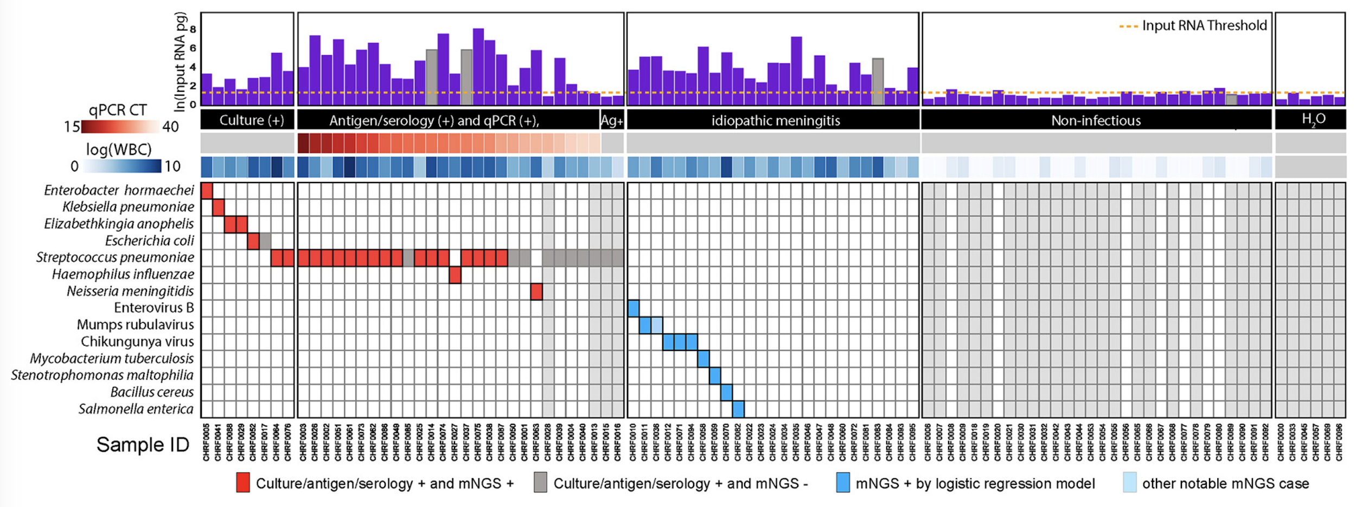
Use case: Saha et al., mBio, 2019
mNGS to identify etiologies of pediatric meningitis in Bangladesh
Known Positives
Unknown
Known Negatives
Water Controls
Collect Patient CSF Samples
Microbial Culture, PCR, Serology
No pathogen identified by standard testing
No pathogen identified; symptoms resolved quickly
Revised 01/12/2026

Slide 13
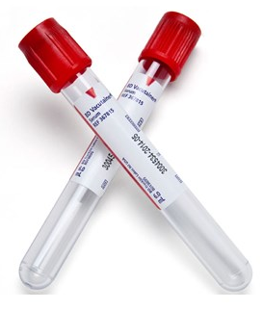
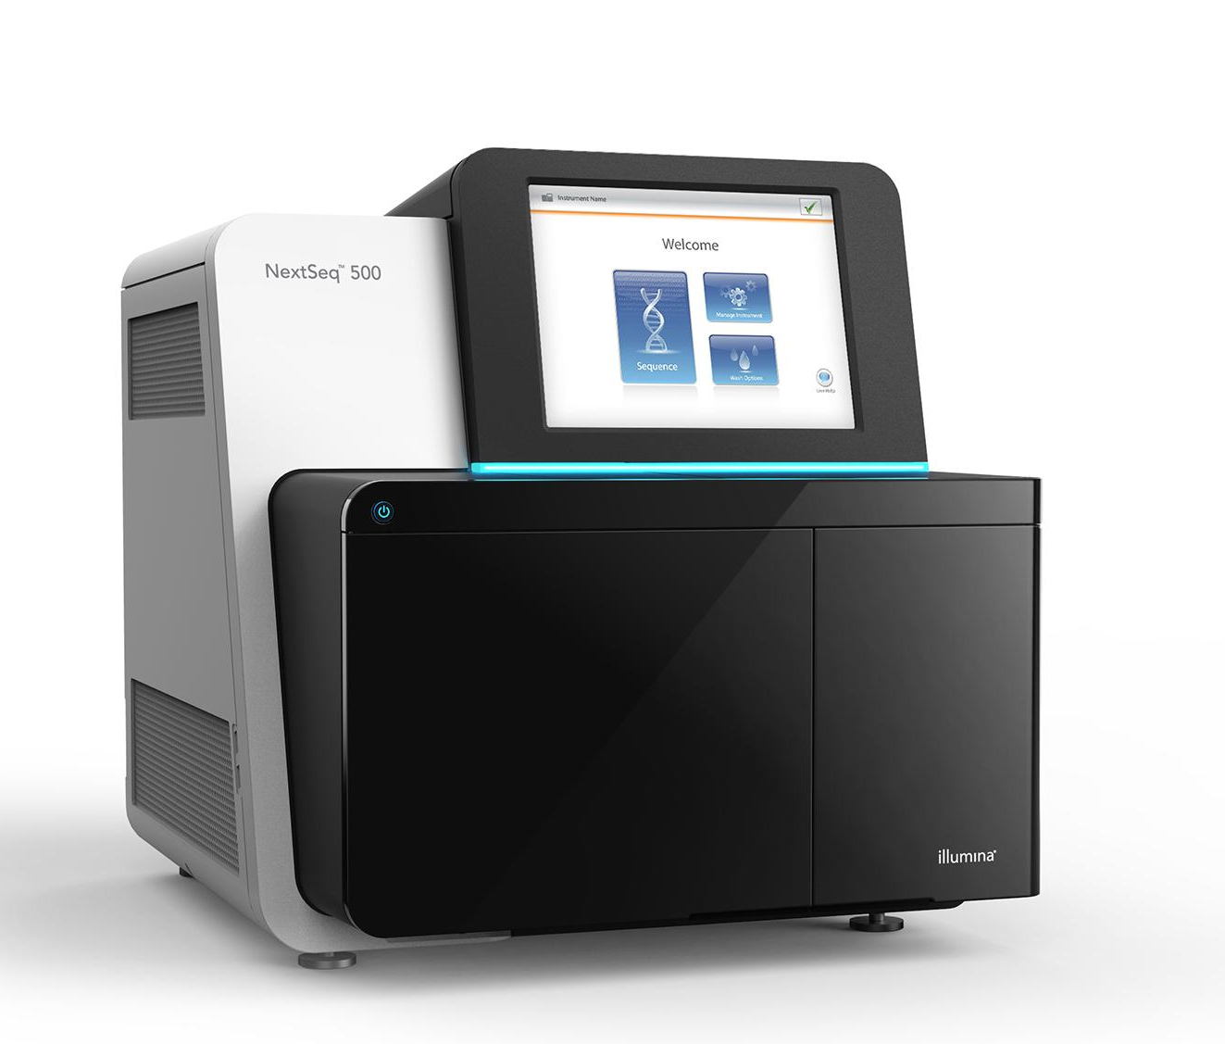
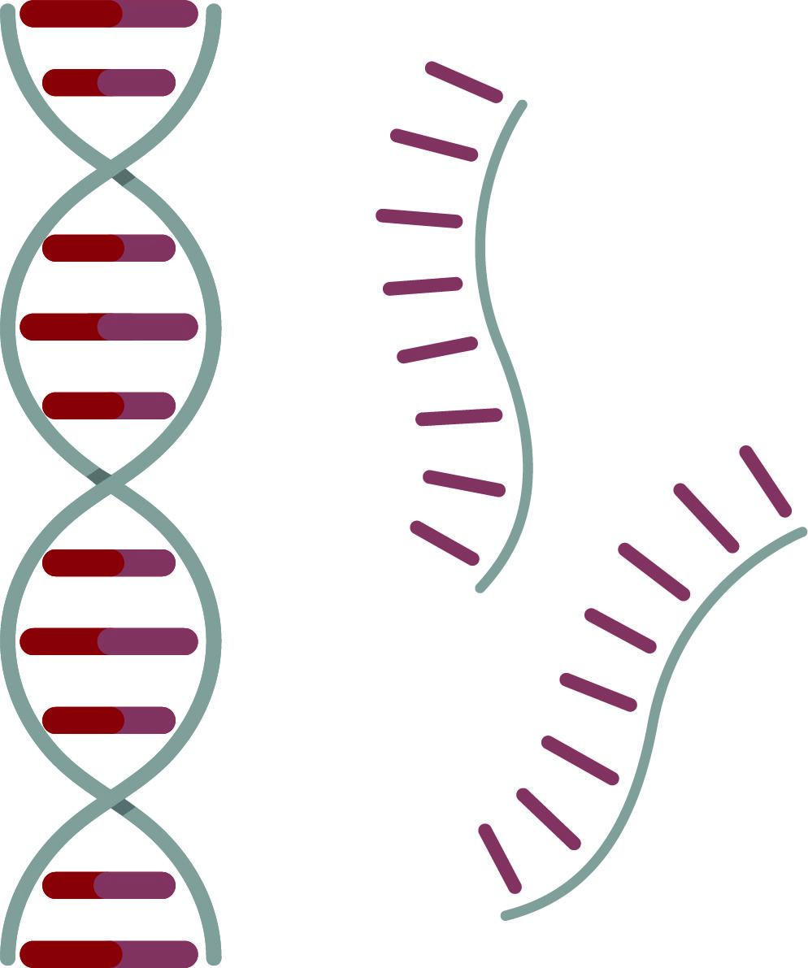
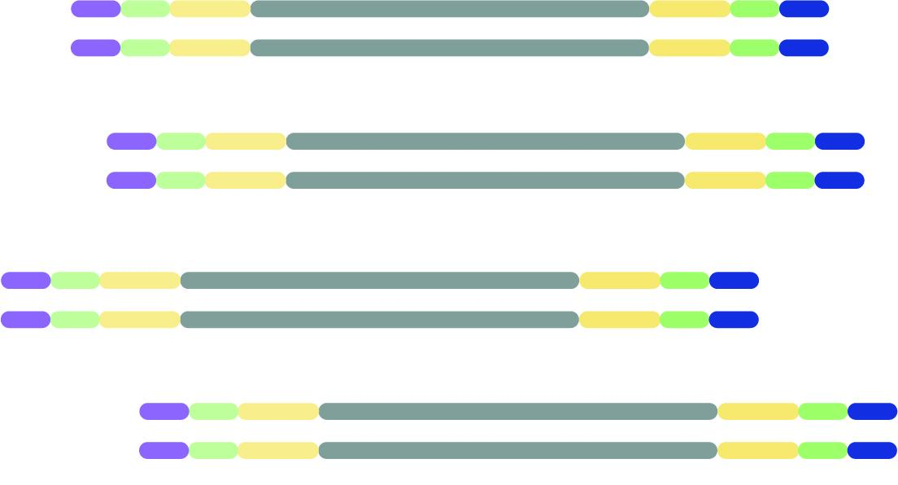


mNGS pipeline
Study design
xNA extraction
Library prep
Sequencing
Data analysis
Pathogen ID
(1-2 hrs)
(1-2 days)
(0.5-3 days)
(0.5-4 hrs)
Type(s)
Controls
Storage
Lab setup
Type(s)
Controls
QC
Host removal
Fragmentation
dsDNA generation
End-repair
Adapter ligation
Barcoding & PCR
Clean-up
Pooling
QC
Machine
Read length
Loading conc.
QC data
Host removal
Alignment
Blast
Ranking of hits
Revised 01/12/2026

Slide 14
Lab setup
Pre-PCR lab
Post-PCR lab
It is critical to have separate pre- and post-PCR lab spaces!
Revised 01/12/2026

Slide 15
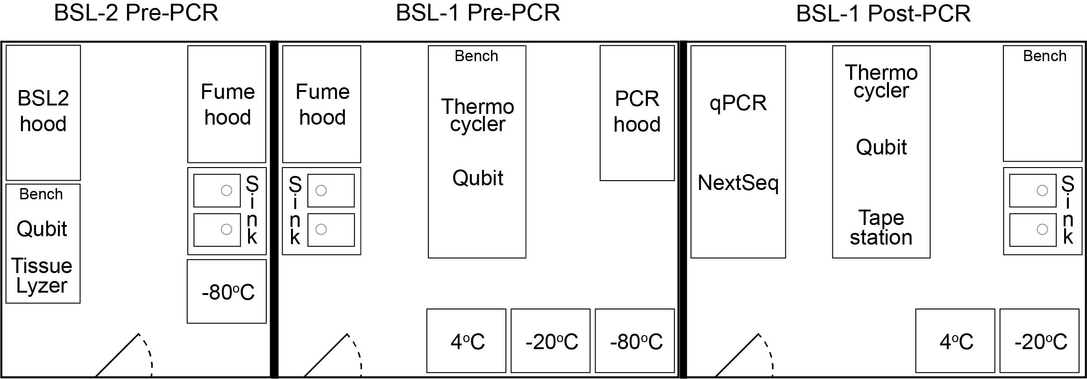
Lab setup
Follow institutional guidelines for biosafety containment
Biosafety level 1 - 2 - … (BSL-1, BSL-2, …)
Note: Shield inactivates dangerous pathogens -> Biosafety level 1
Avoid dust and high humidity levels
Preventative measures to avoid PCR amplicon contamination at all cost
Physical separation of Pre-PCR and Post-PCR
Extra lab precautions (see next slides)
Revised 01/12/2026
Notes:
If you cannot separate Pre and Post PCRs into two separate rooms, try to make “a room within a room” for the post-PCR. Alternatively, be strict with the assignment and use of PCR workstations/ cabinets

Slide 16
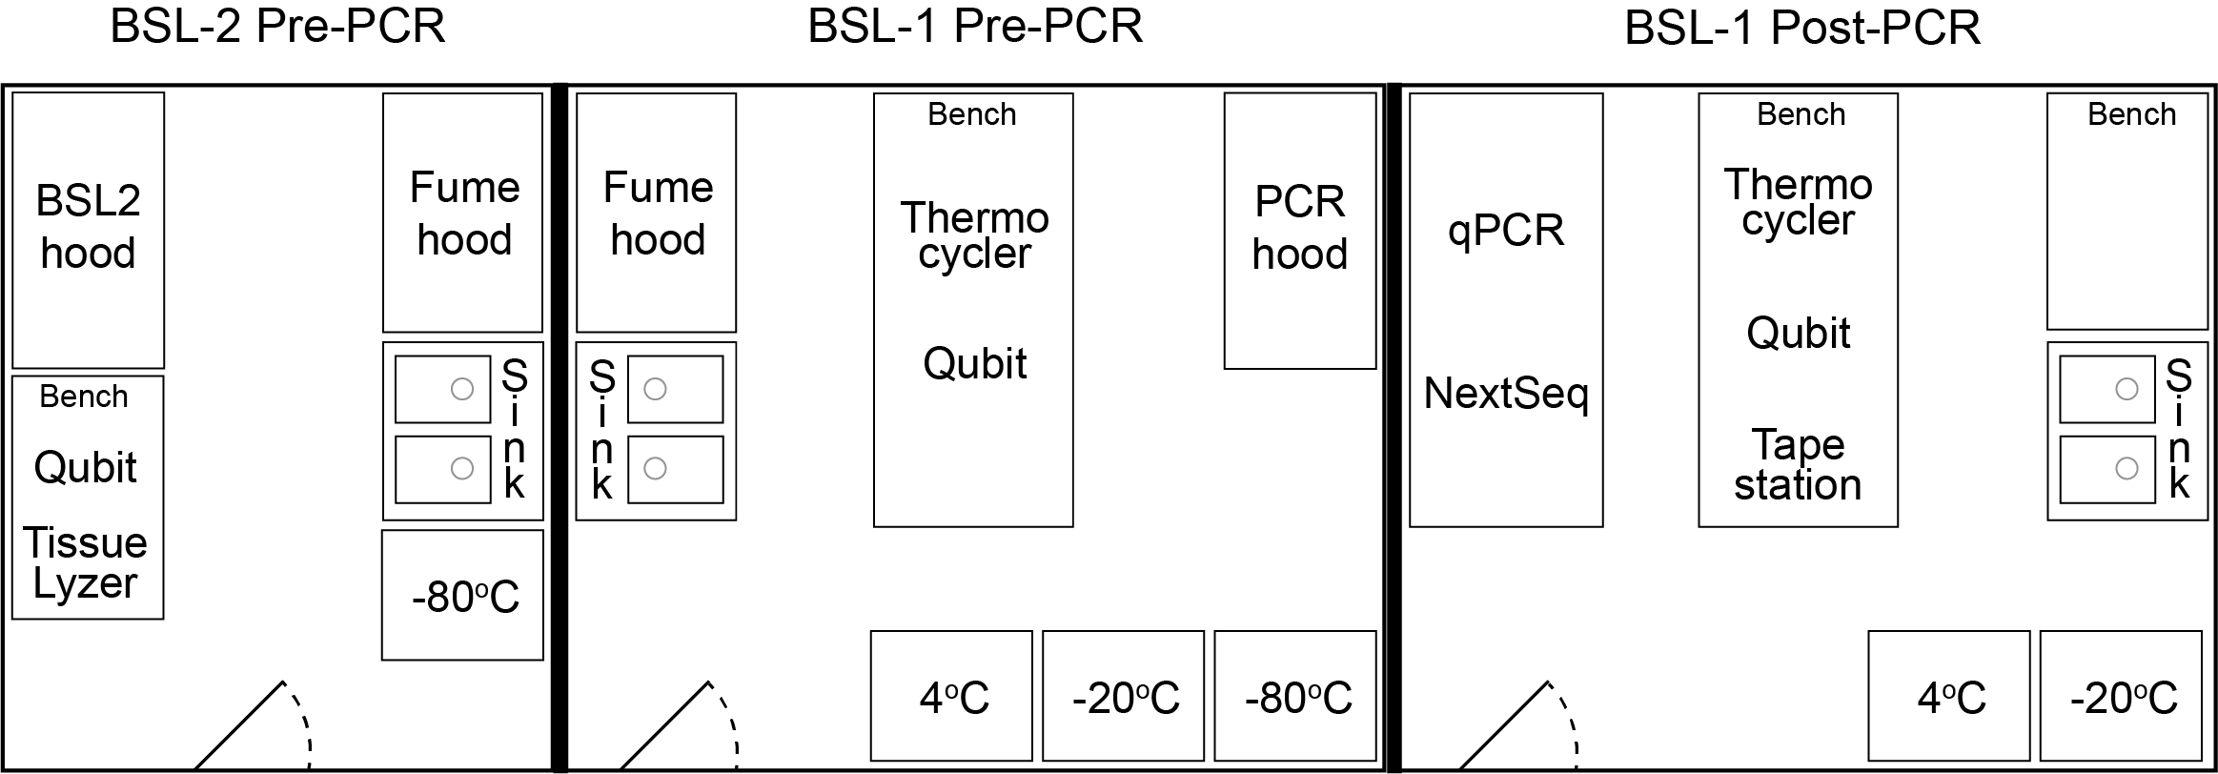
Lab setup
BSL-2 Pre-PCR
BSL-1 Pre-PCR
BSL-1 Post-PCR
No PCR allowed
xNA extractions of infectious samples
No PCR allowed
xNA extractions
Lib prep up to setting up the Q5 mastermix (no PCR)
Lib prep from barcoding PCR
Lib QC
Lib amplification if needed
Sequencing
Revised 01/12/2026
Notes:
Metagenomic sequencing of samples with low nucleic acid content (i.e.: CSF, serum, plasma) can be easily contaminated with nucleic acid in the lab environment.
PCR amplification produces high abundance of nucleic acid which can be a major source of contamination
To prevent this environmental contamination, we separate the physical locations of the lab procedures into 2 spaces: Pre-PCR and Post-PCR. Some institutions refer to them as Pre-amplification and Post-Amplification lab

Slide 17
Lab setup
Extra lab precautions:
Sticky floor pads at the entrance of Pre-PCR rooms, changed weekly
Ice buckets color coded to the lab spaces - either Pre-PCR or Post-PCR only - no mixing
Rotation of index primers so the same indices are never used in the same month
Reagents like H₂O, SPRI beads, DNAse, Proteinase K, etc are aliquoted into single-use tubes
Pipets inside the PCR hoods are never taken out. All hoods are sprayed down before and after use with 70% ethanol and RNAseZap
Reagents are not shared between the different rooms
PCR products never enter the Pre-PCR rooms nor samples with high nucleic acid quantities (i.e.: stool, tissues, bacterial cultures, bacterial colonies)
Revised 01/12/2026

Slide 18
Lab setup
Other considerations:
Power: Uninterruptible power supply (UPS) or surge protector
Internet connection
Environmental conditions, e.g. for iSeq:
Dust issues: Pollution degree rating of II (non-conductive pollution only, rare conductive pollution)
Ventilation: Up to 2048 BTU/hr @ 600W. Buy extra air filters for the iSeq.
Humidity: Non-condensing 20-80% Relative Humidity
Temperature: 15°C to 30°C (22.5°C ± 7.5°C)
Revised 01/12/2026

Slide 19
Lab setup
Lab procedures by location
BSL2 Pre-PCR Biosafety Cabinet
Sample inactivation in DNA/RNA Shield
Nucleic acid extraction (if sample is not deactivated)
BLS2-Pre-PCR Room
Storage of original samples at -80C
BSL1 Pre-PCR PCR hood
Nucleic acid extraction (if sample is deactivated)
Nucleic acid quantification/quality control:
Aliquots can be made in Pre-PCR and run in Post-PCR
DNA/RNA library prep: Fragmentation to setting up the barcoding PCR
BSL1 Post-PCR PCR hood
Post-PCR SPRI clean-up
BSL1 Post-PCR Bench
Barcoding PCR amplification run
Library quantification & quality control
Library pooling
qPCR Machine for additional library amplification
Illumina sequencing
Storage of NGS libraries -20C
Revised 01/12/2026
Notes:
50 minutes

Slide 20
Next: mNGS study design, lab setup and sample preparation
Revised 01/12/2026

